Slide 1
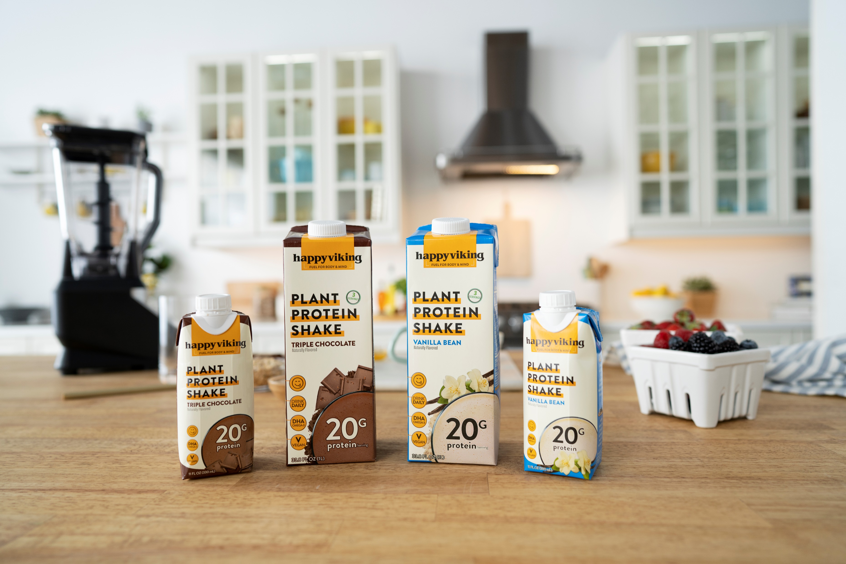
DYLA Brands
Social Content Creator Final Presentation
JEREMIAH ADEOLA

Slide 2
overview
Internship Goals
Orchestrate and plan content and strategy for organic growth
Developing a deeper understanding of paid social strategies
Participating in agency meetings and partnerships
Networking across marketing relevant backgrounds and experiences

Slide 3
strengths and weaknesses
Strengths
Graphic design
Art direction
Presentation and research
Weaknesses
Video content creation
Opportunities
Product photography
Market and competitor analysis
Threats
Platform learning curves

Slide 4
part one MARKET RESEARCH & CONTENT STRATEGY

Slide 5
competitor analysis
Prior to discussing content, understanding the competitive landscape allowed our team to analyze trends, best practices, and how we could best align our brand with a winning strategy.
Project Briefing
Analyzing paid social, influencer, and display advertising efforts from 3 main Happy Viking competitors (Ka’Chava, OWYN, Vega)
Providing recommendations for HV in accordance with our branding pillars and potential content

Slide 7
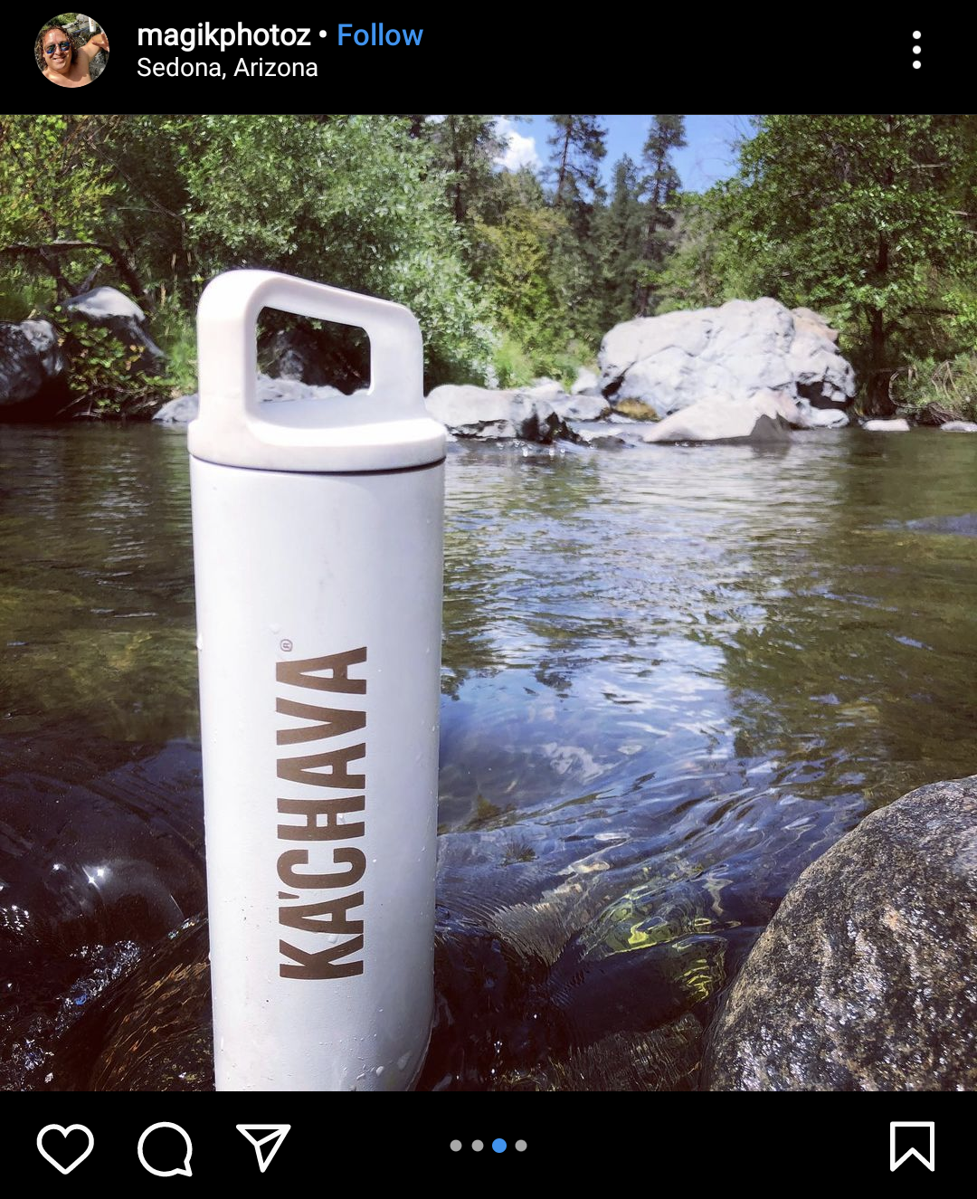
influencer strategy
Guerilla marketing strategy
All but 2-3 accounts (family, lifestyle, and recipe accounts) were under 5K followers
Larger accounts ranged from 26K to 75K
At least 2/3 of tags were recipe focused
Photographer tags
2+ posts from photography accounts using branded Ka’Chava bottle in scenic location
One-off posts
No promotional codes

Slide 8
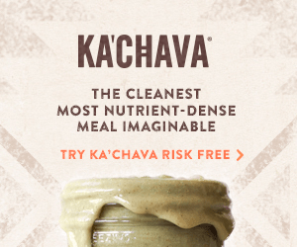
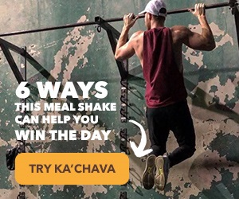
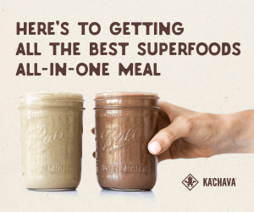
display ad strategy

Slide 10
paid social strategy
About 70/30 split between static/video content
“Fuel/Feel like the best”
Static creative often just generic product shots
Newer video content only featured on Facebook and Instagram instead of Audience Network and Messenger
Linked directly to product page
Older ad copy and creatives featured user reviews and testimonials

Slide 12
paid social strategy
*Ad research affected by age restrictions
Older campaigns utilized Facebook, Instagram, Audience Network, and Messenger
Newer ads only target Facebook and Instagram
Potentially higher CPC or CPR for Audience Network and Messenger
Healthy mix of both static (about 60%) and video (~40%) creative
Older video leaned into featured UGC
Directly named or assessed against non-plant-based nutrition solutions (Ensure)
Offers were previously linked to a landing page with an offer (20% off)
Currently directed straight to product page
Copy focuses on issues (stomachache, lumpy shakes, cheat meal and hunger cravings) as “not needed” and OWYN as a solution
Most of ad copy is geared towards building trust from its natural ingredients
Stresses free shipping
Potential solution to high add to cart abandonment

Slide 13
hv content strategy
In creating new content for Happy Viking social channels, we explored Tik Tok as a new avenue for video content, given the rapid growth and success of other brands on the platform.
Project Briefing
Research other active CPG brands on Tik Tok and how they released and created video content or engaged with their audience
Suggest a general strategy, complete with trends, content cadence, and video ideas, for a Happy Viking Tik Tok account

Slide 14
tik tok strategy overview
The HV tone and style should mimic that from other social channels, with a slightly more candid and personal feel
Want to maintain a bright, relatable, and cheeky voice across video content
Allow our brand’s personality and mission to passively take center stage
Showcase Team HV
“Vlog style” personable content is king
Self aware and authentic jokes/ideas are more valuable even if at the expense of production quality and the explicit mention of product features
Reel people in with funny/entertaining content, and then mix in less flashy product content
Similar to IG content

Slide 15
content strategy
4 Main Content Buckets
Smoothie/powder recipes
Product benefits
Nutritional education (plant-based benefits)
Candid entertainment (relatability, Venus)

Slide 16
trend/challenge ideation
Current trends
Adult Swim trend [entertainment]
Popular songs (ex. good 4 u, Beggin’) [recipes]
“International Super Spy”; using plant-based protein as ‘deceptively’ good alternative to regular protein solutions [entertainment]
Original ideas
Happy Dance challenge (#WhatsYourHappyDance)
Tie to giveaway with HV powder at release?
Plant Curious Q+A

Slide 17
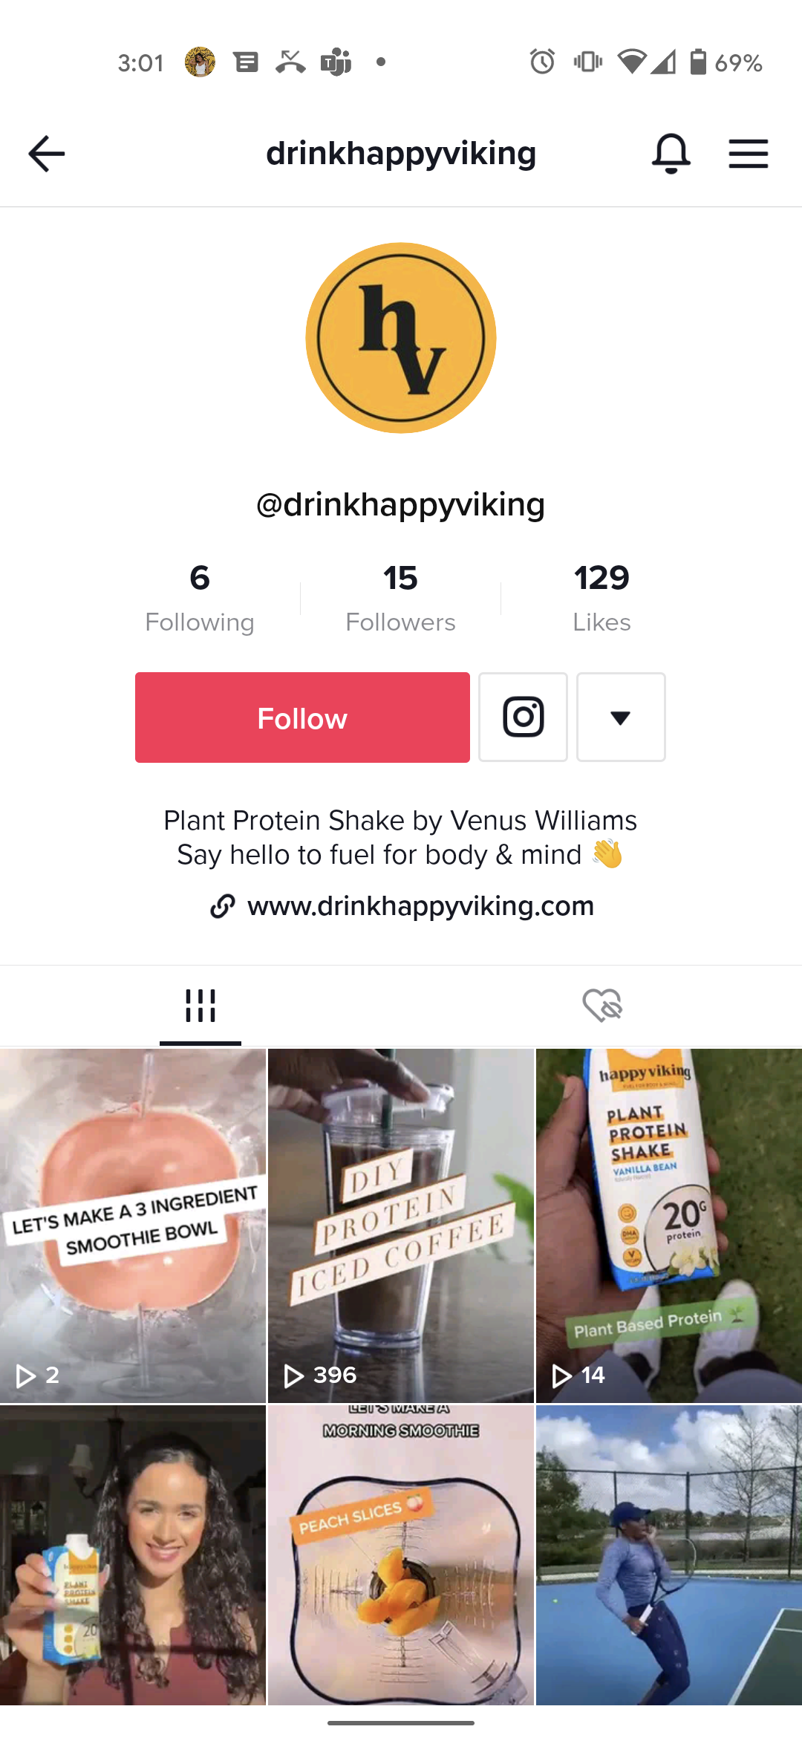
hv tik tok creation

Slide 18
part two ART DIRECTION

Slide 19
graphic cards
For our Instagram account, we wanted to have a healthy range of content to pull from and use graphic cards to break up and populate our feed.
Incorporate Happy Viking colors and branding
Encourage or inform audience on product benefits
Create fun or entertaining content for engagement

Slide 20
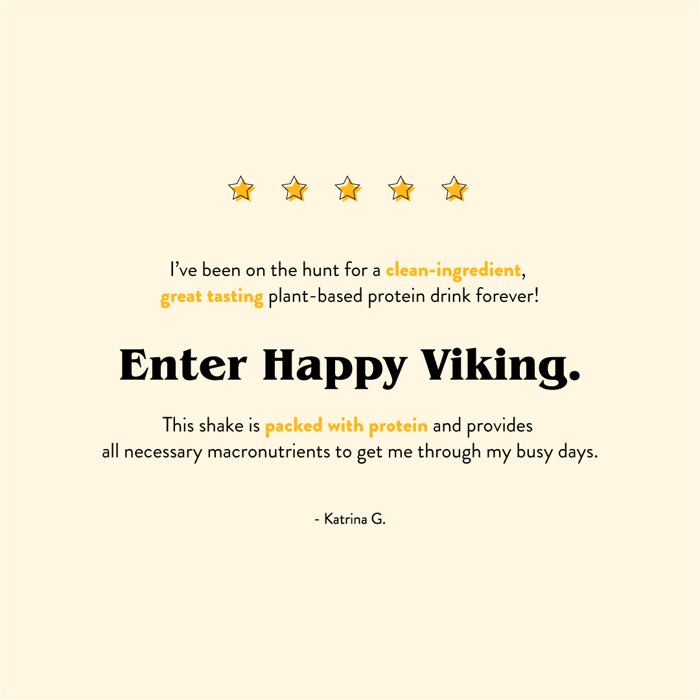
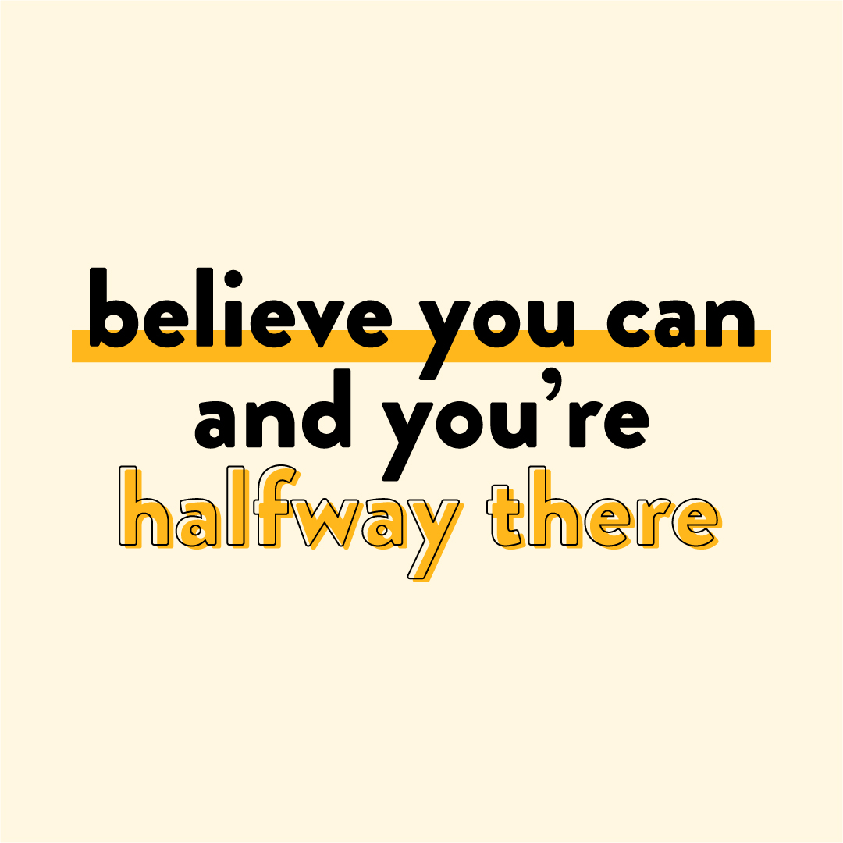
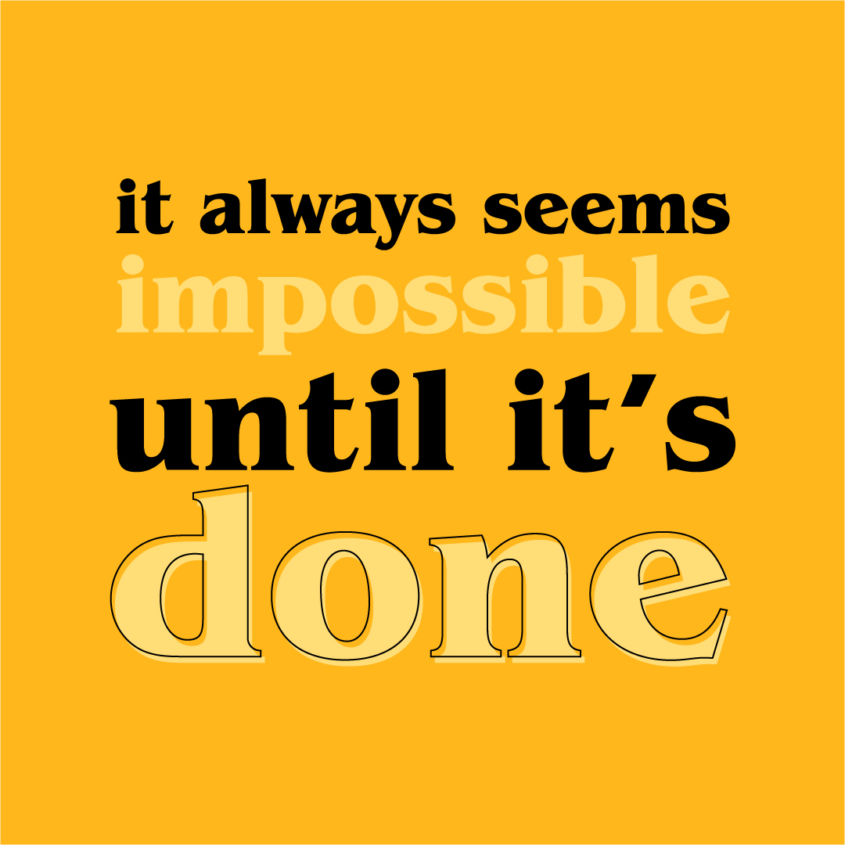
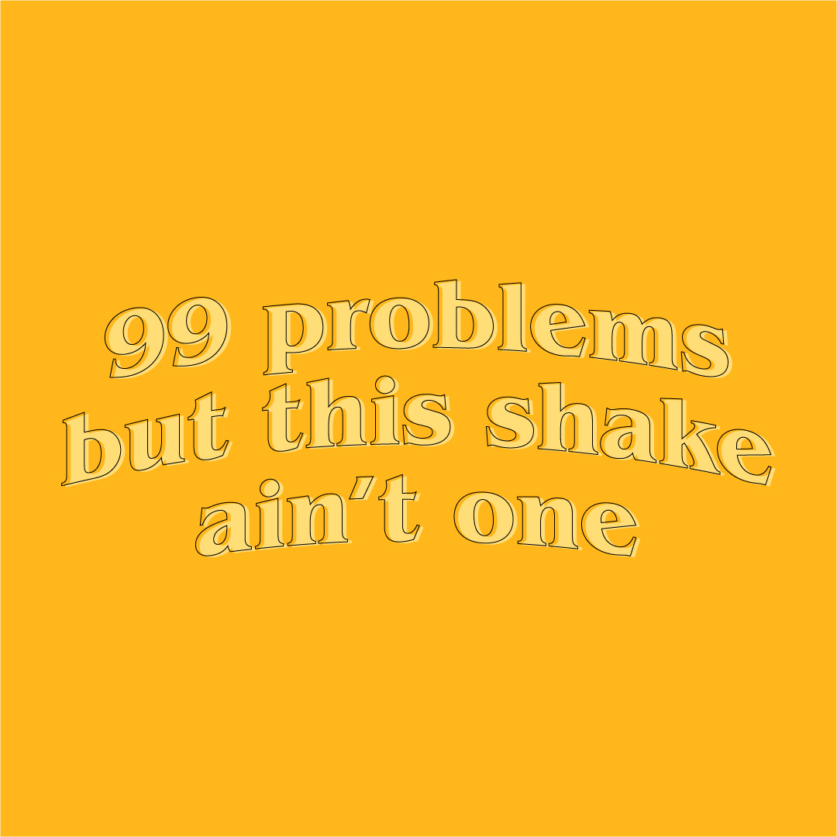
graphic cards

Slide 21
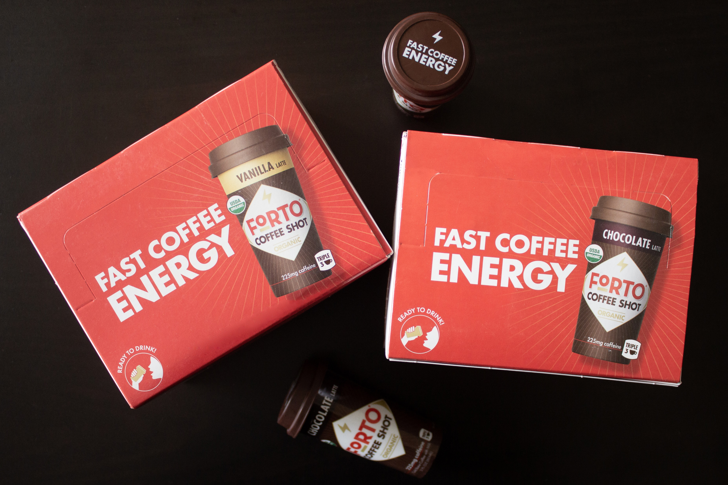
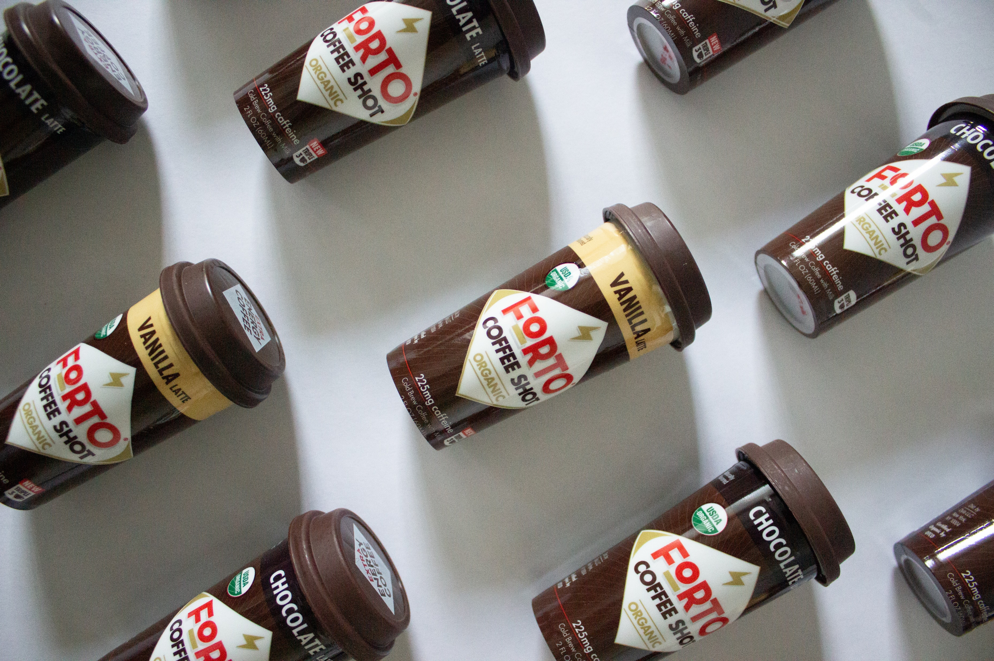
graphic cards

Slide 22
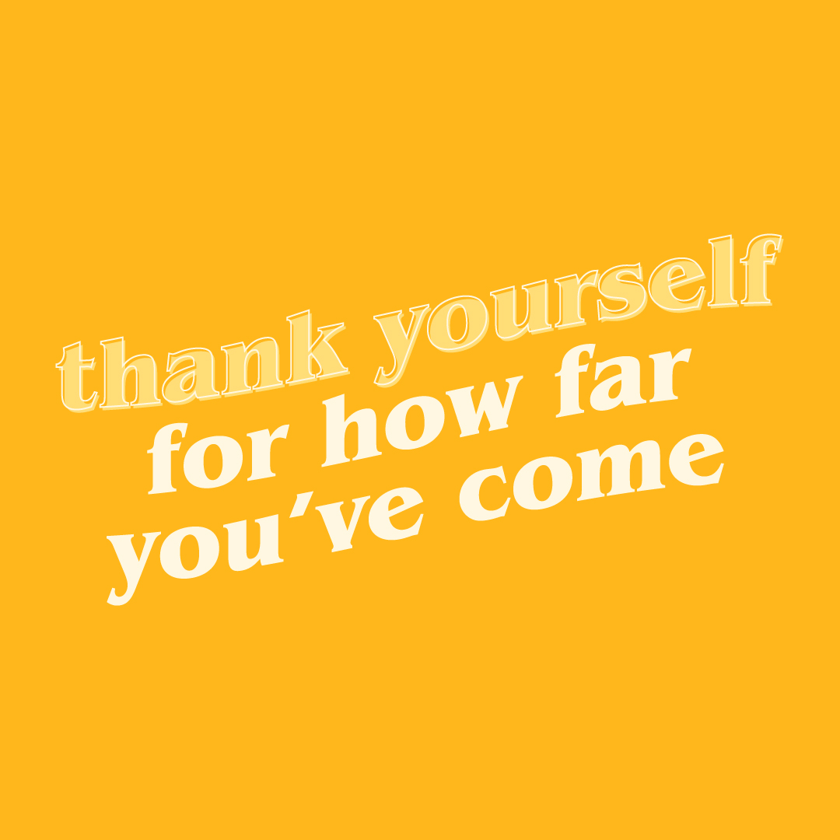
by the numbers
7,350 Unique accounts reached
583 Likes
107 Comments
38 Saves
28 Shares

Slide 23
spotify playlists
Venus-based content always performs well and produces engagement with our Happy Viking audience, and we were inspired by Venus mentioning her love of music and karaoke to use Spotify as a new avenue for content.
Project Briefing
Populate a Happy Viking Spotify account with 3 to 4 playlists related to the HV brand
Design cover art for each of the playlists
Create a carousel deliverable with each of the covers and tracklists to be posted on Instagram

Slide 24
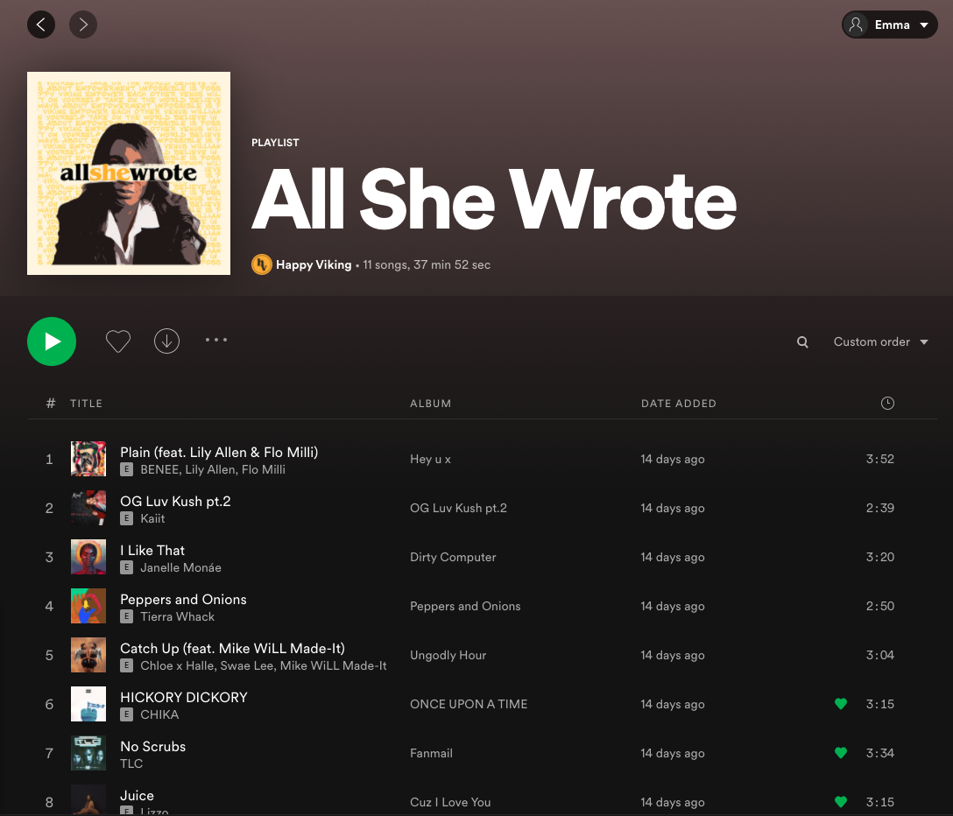
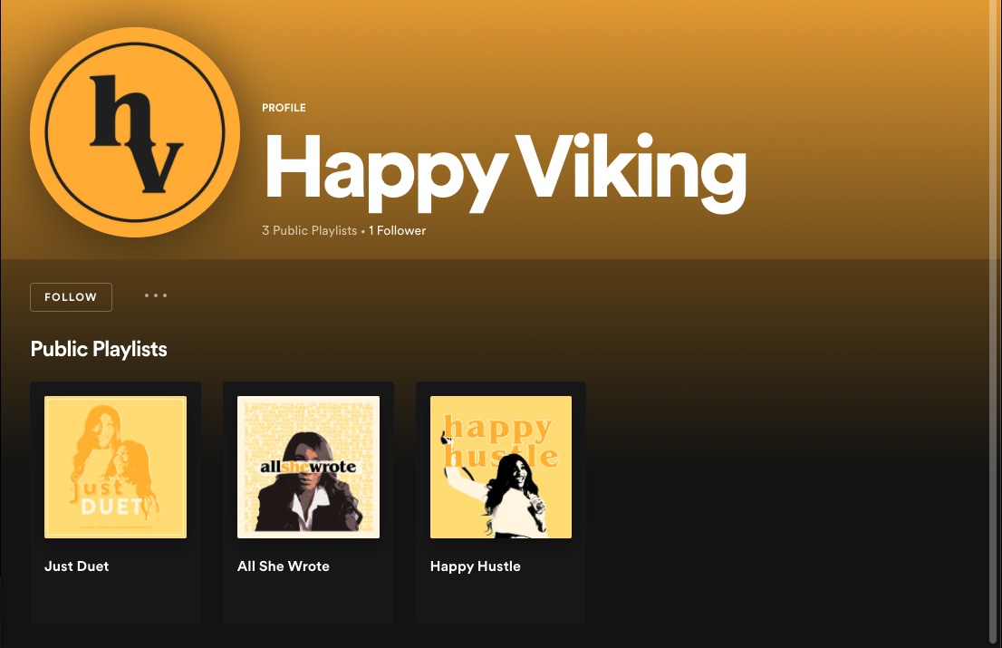
spotify playlists

Slide 25
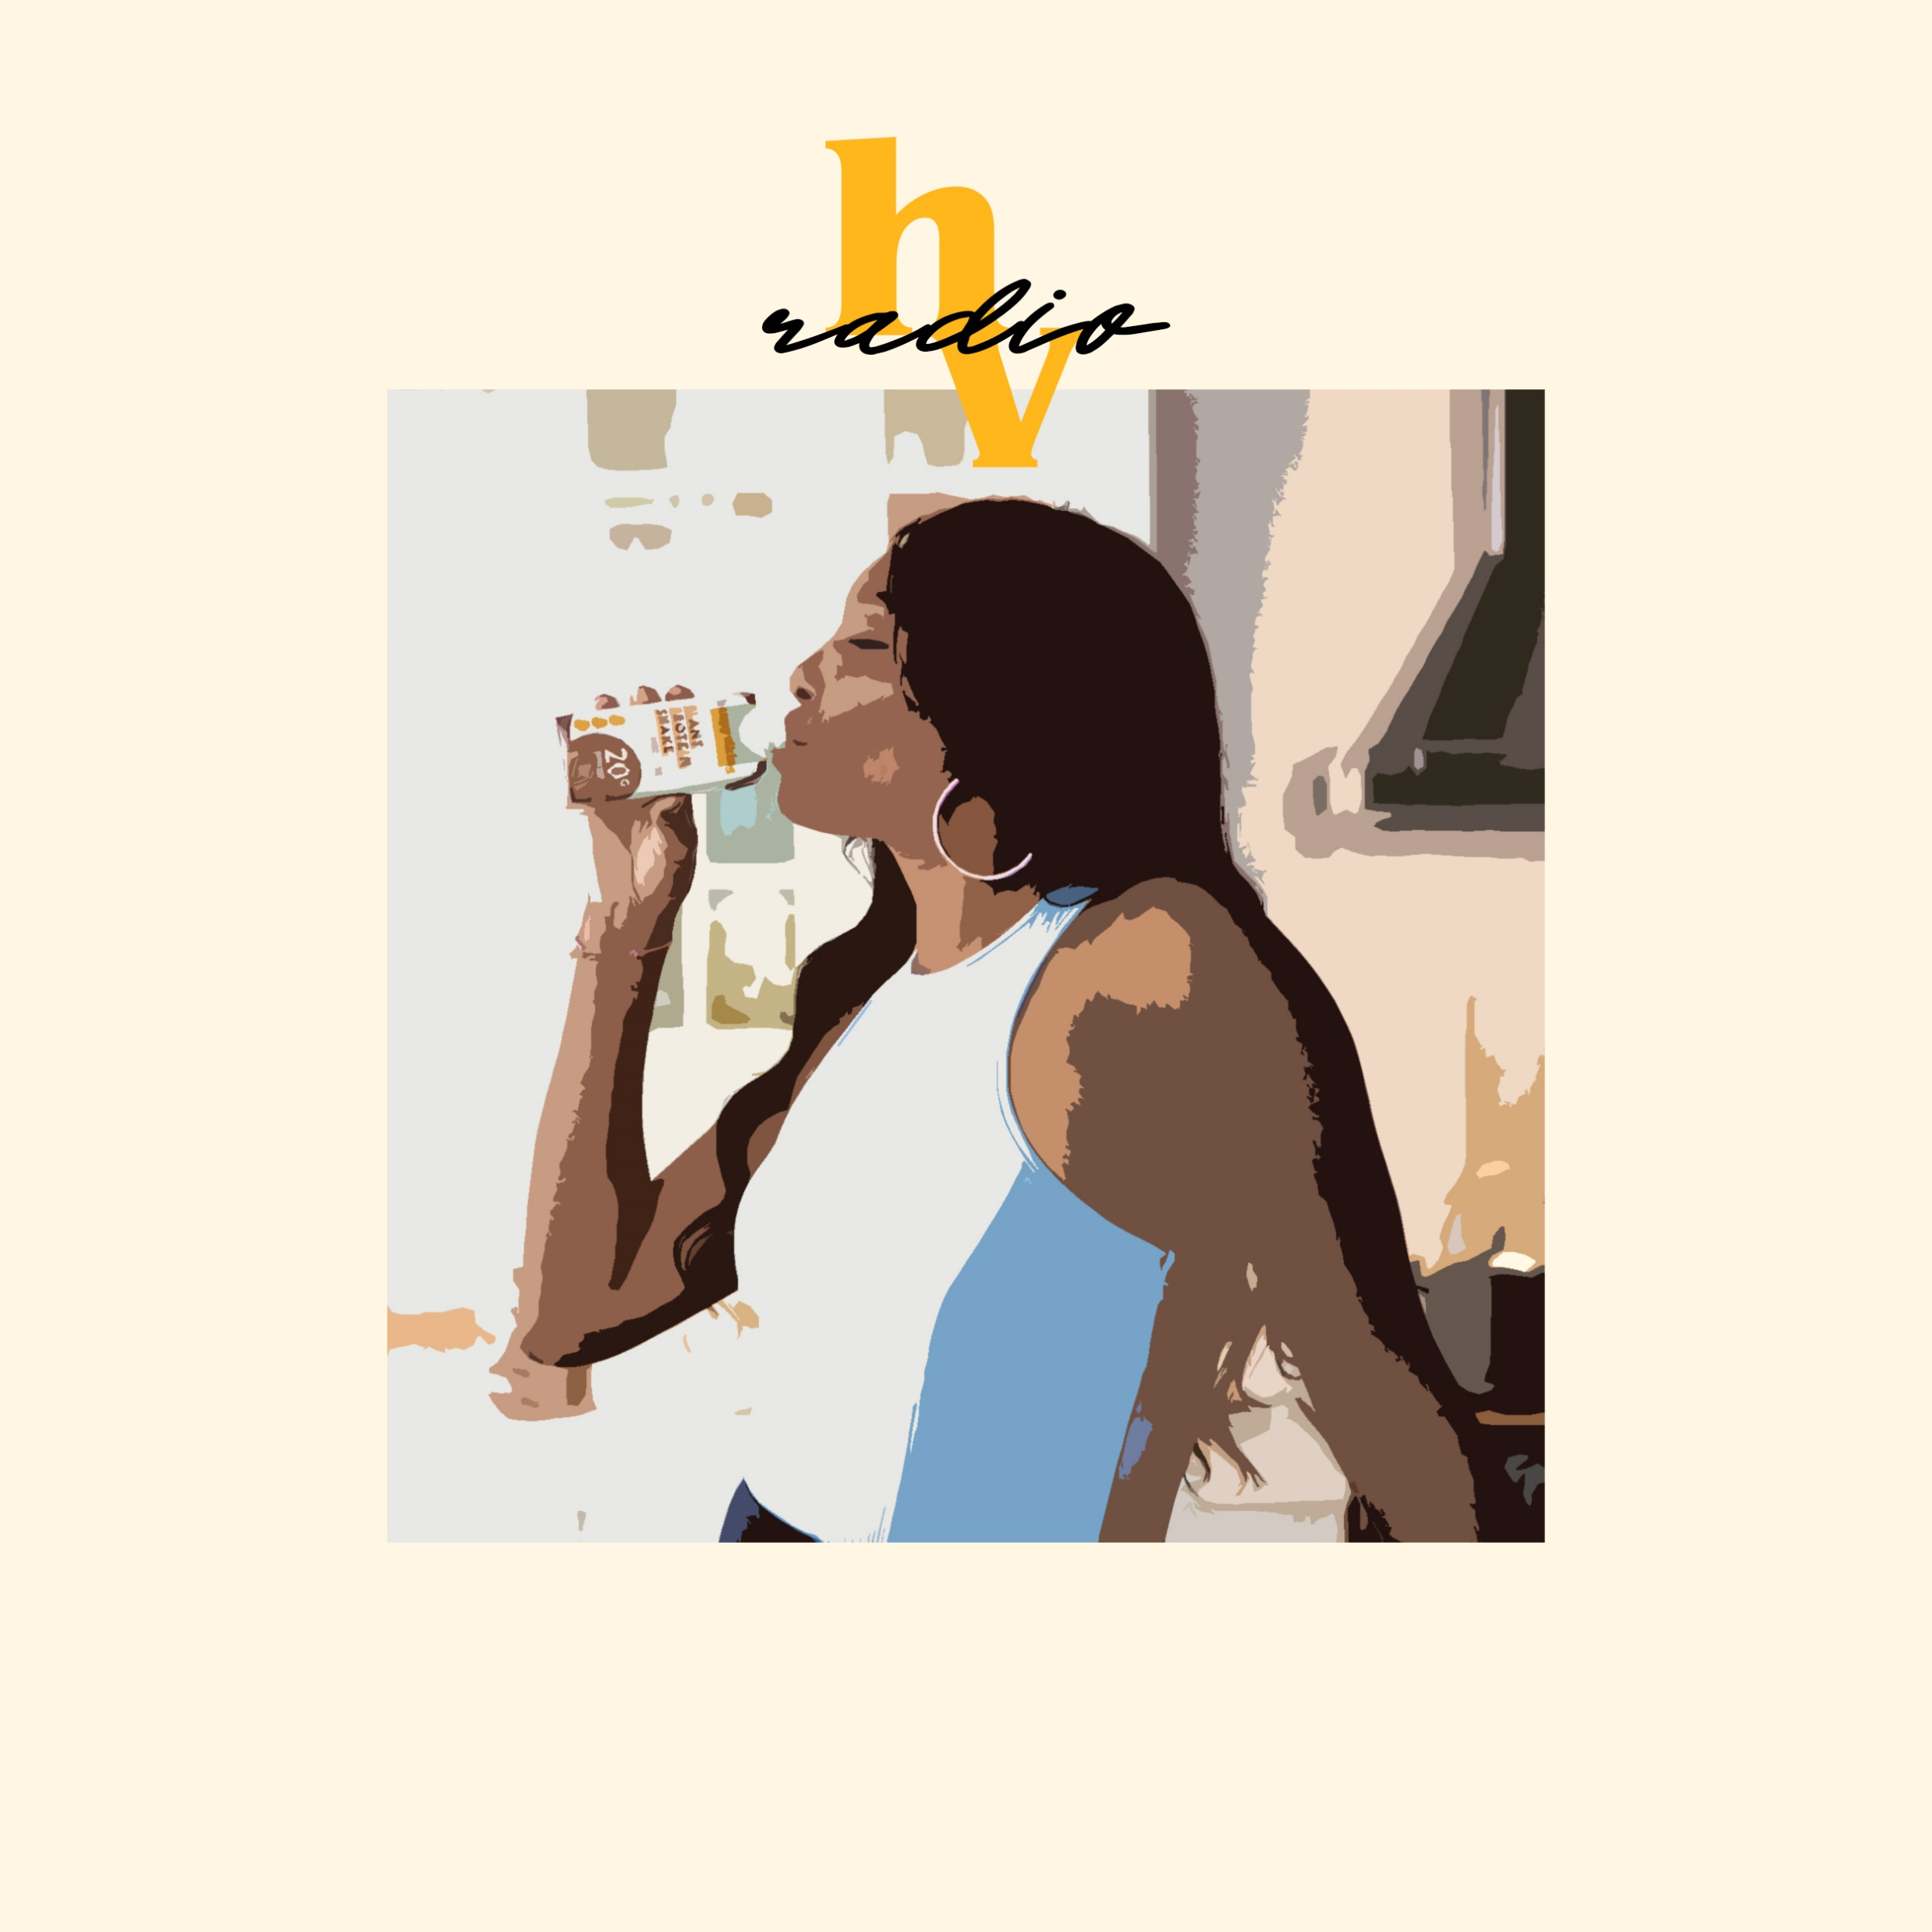
HV RADIO
Genres: Pop, Alternative
General feel-good playlist
Upbeat tempo
Danceable, happy energy
Can be played in the car, headphones during commute or daily activities to boost energy

Slide 26
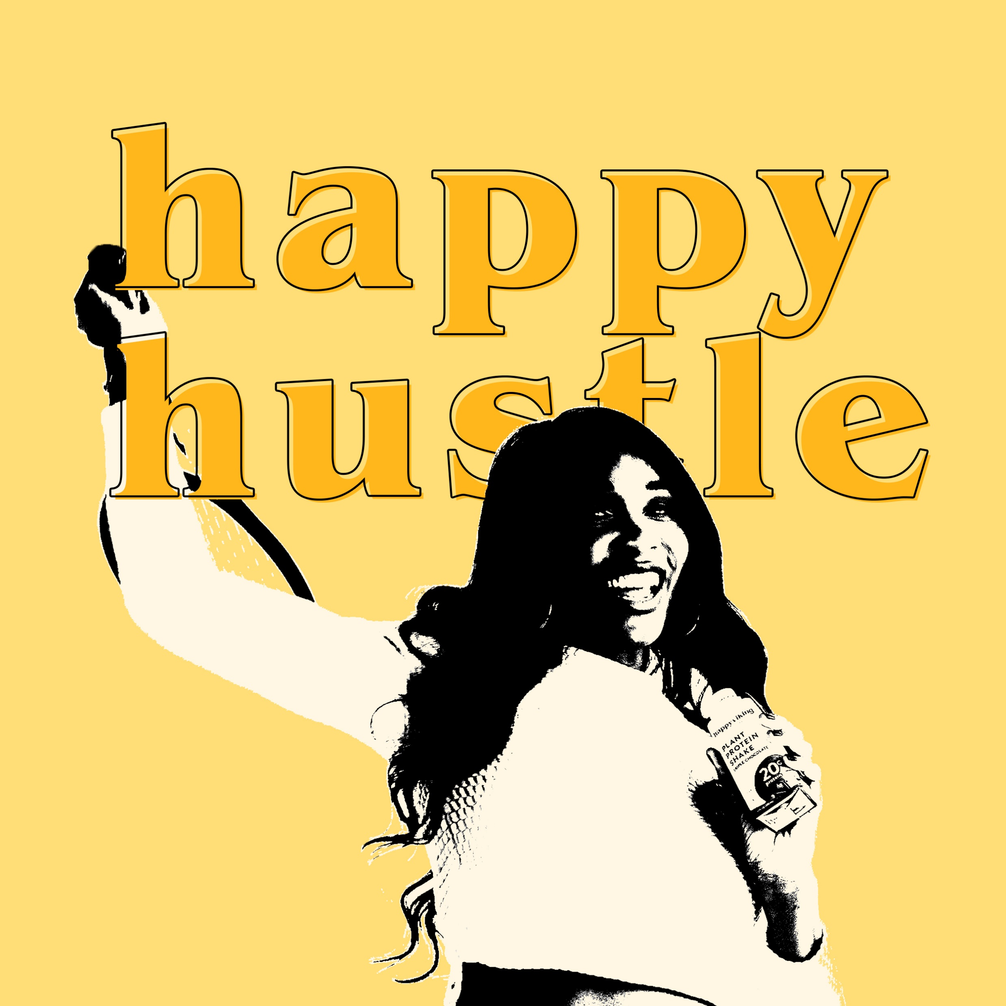
HAPPY HUSTLE
Genres: Rap, Hip-Hop, Pop
Workout and gym playlist
Motivational or competitive lyrical themes
Bass heavy, high energy
Can be used strictly for exercise or for motivational mood setting

Slide 27
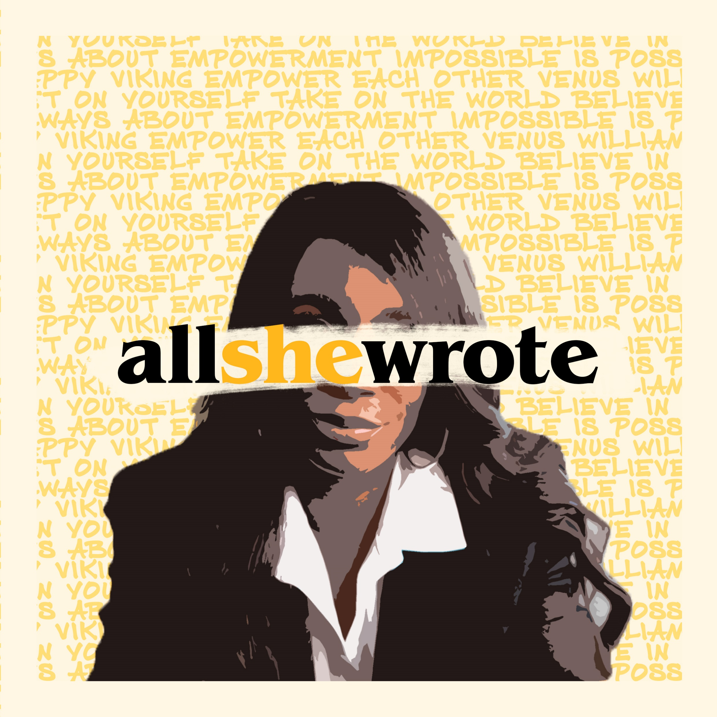
ALL SHE WROTE
Genres: Rap, Hip-Hop, Pop, R&B, Alternative
Highlighting different women in music
Confident and vulnerable female perspectives and songs
Potential to serve as exposure for smaller female artists to be recognized
Can be updated in the future with new releases

Slide 28
JUST DUET
Genres: Pop, Rock, Alternative, Hip-Hop
Karaoke playlist and sing-along songs
Plays off Venus’ love for karaoke
Features broad range of artists and genres that people are most likely familiar with
Light-hearted, fun energy and theme

Slide 29
instagram highlights
Project Briefing
Research competitors and similar accounts for strategies and practices regarding Instagram story highlights
Suggest content categories for Happy Viking highlights
Design templates for HV story highlights (mission, recipes, reviews)

Slide 30
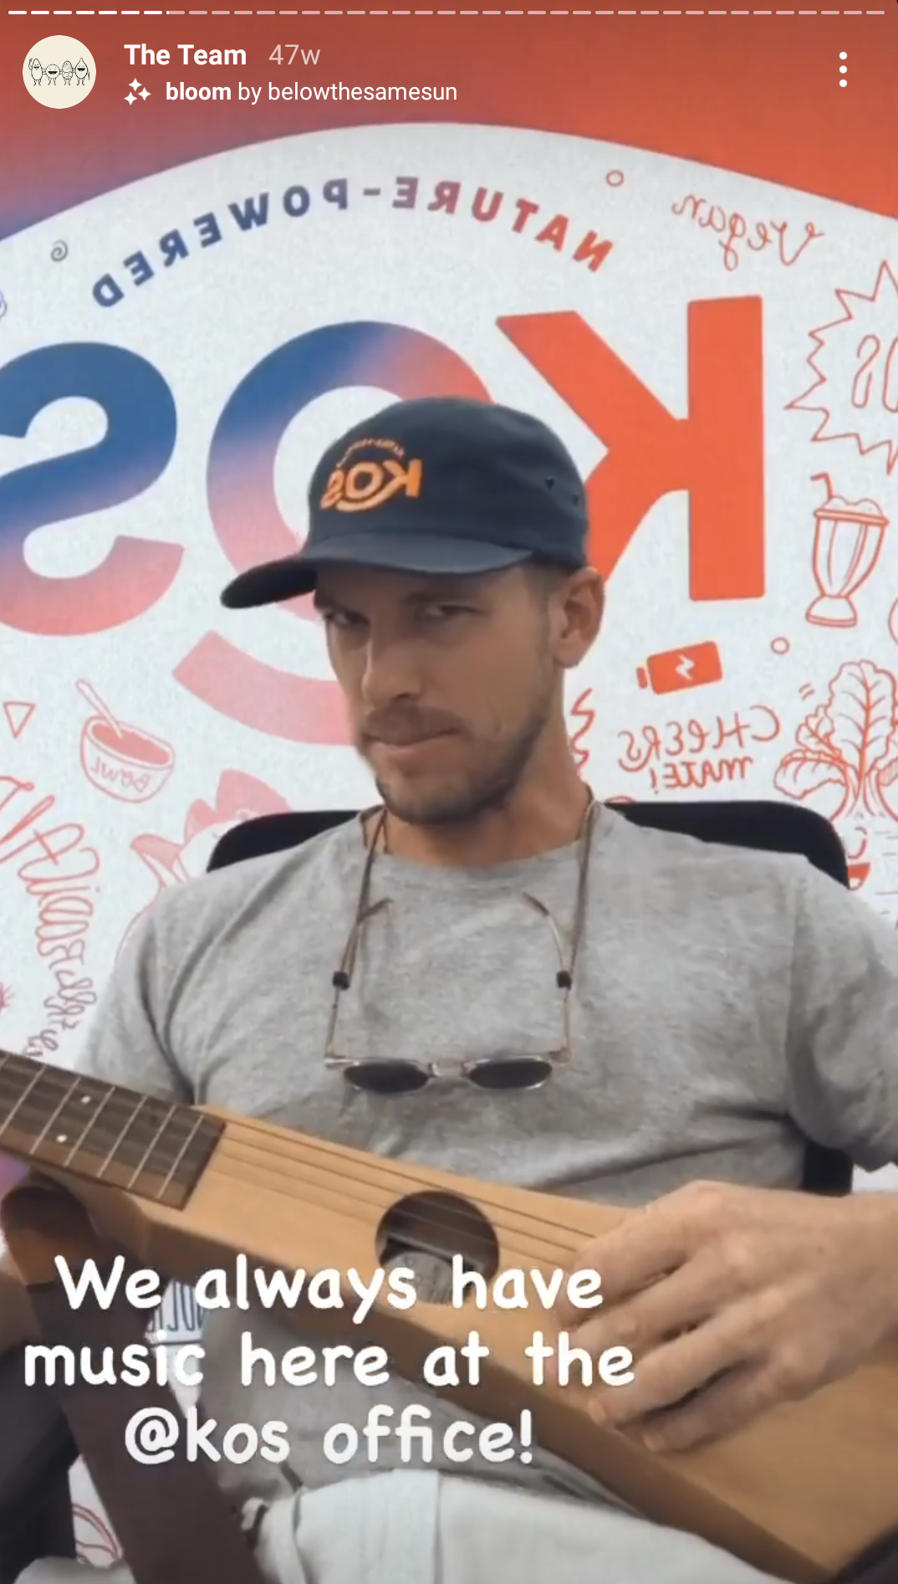
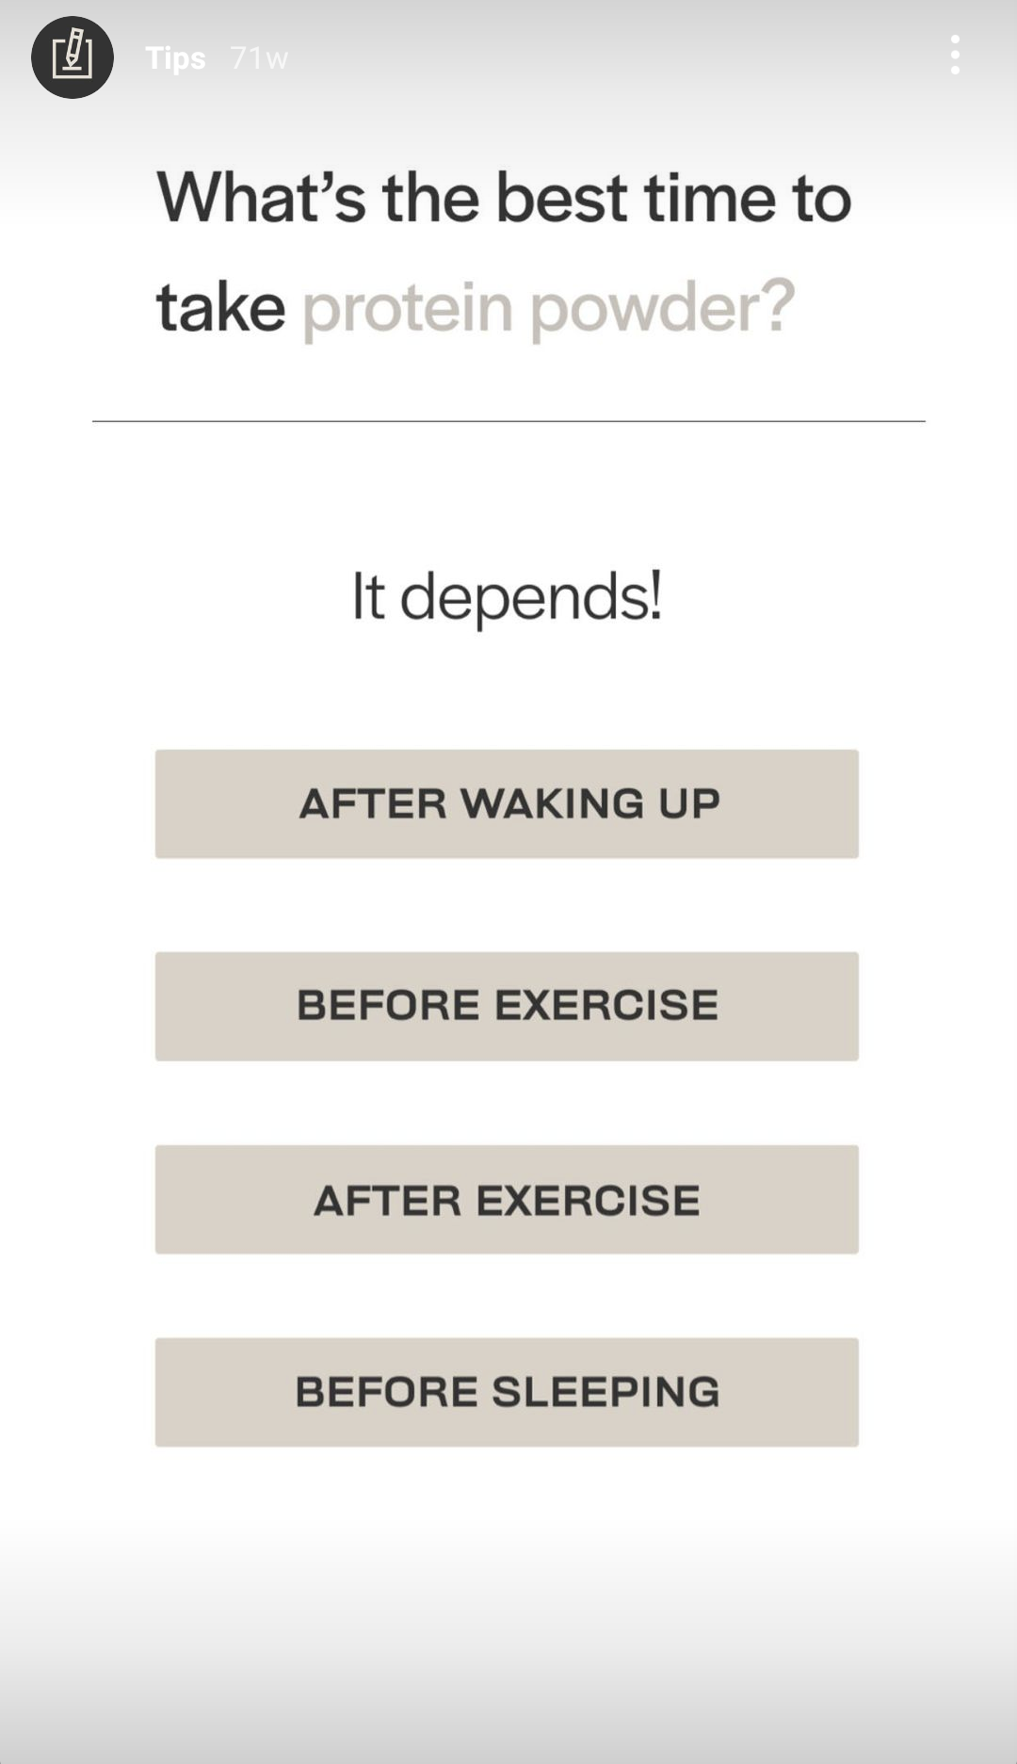
common themes and categories
Recipes
Testimonials (Team HV)
Press
Build brand ethos and credibility
Highlight big announcements or features
FAQs
Product benefits
Company mission (Venus)

Slide 31
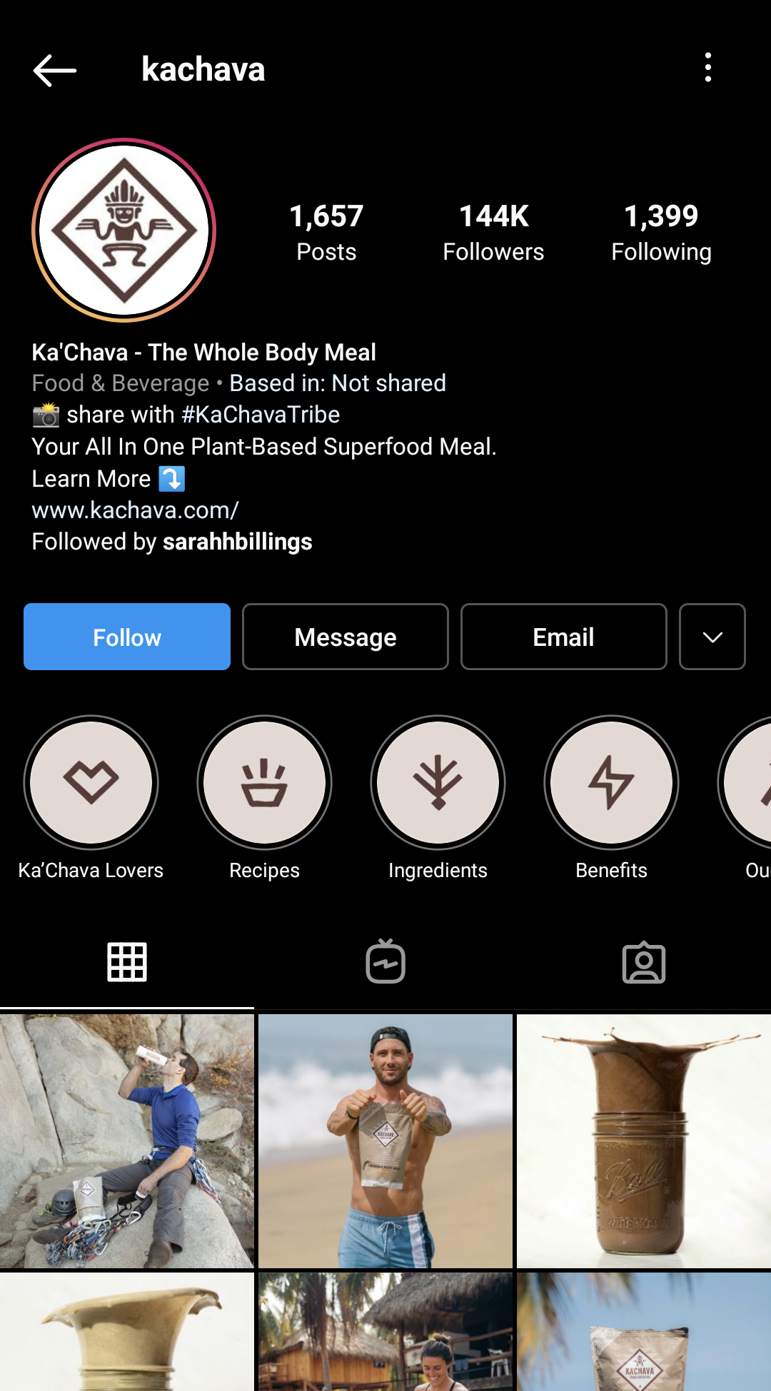
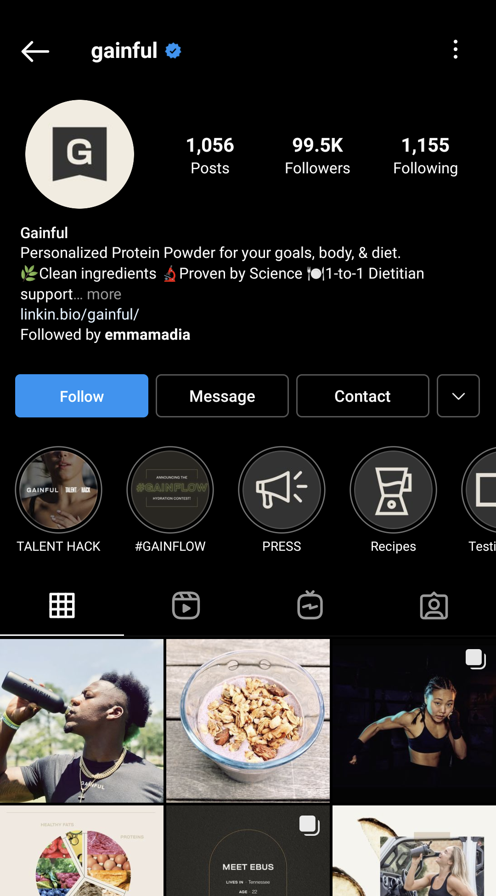
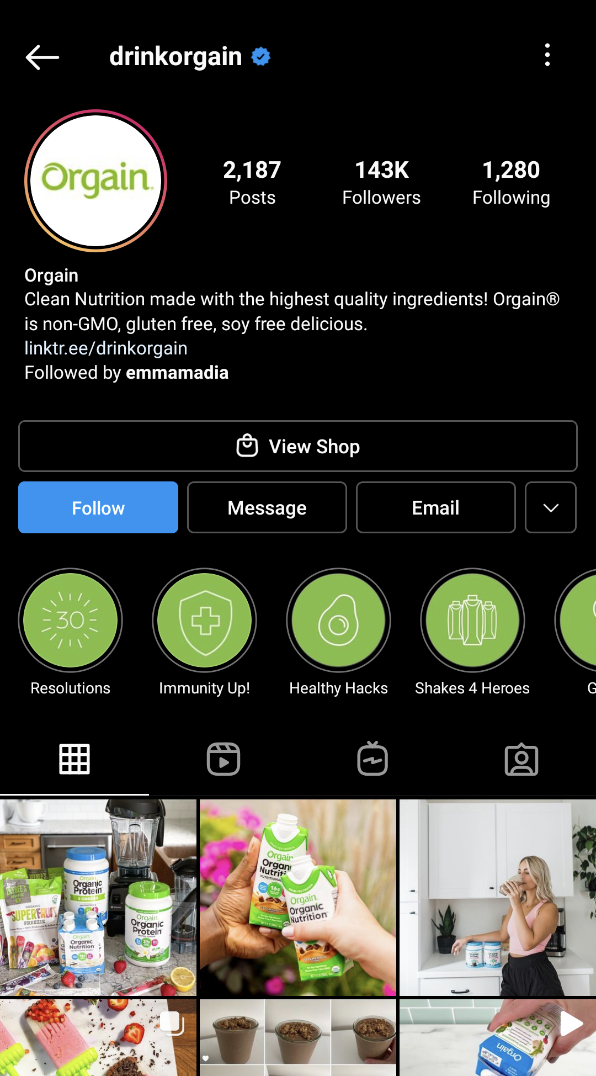
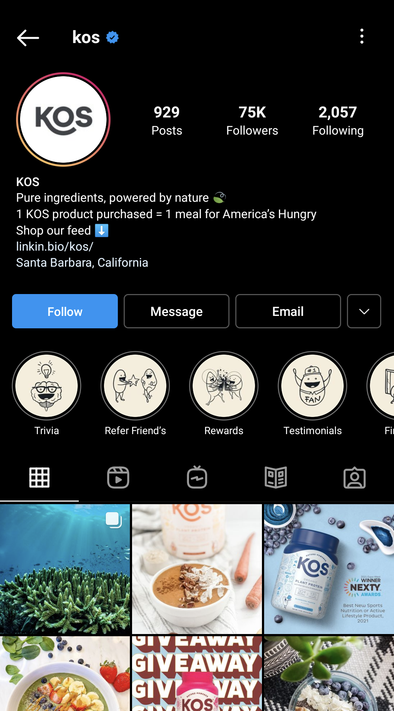

Slide 32
creative deliverables
Pre-made graphics for stories
Sub-10K issue with swipe ups
Recipe cards
Use of white space for text and additional information
Bright, branded colors
UGC typically used for testimonials

Slide 33
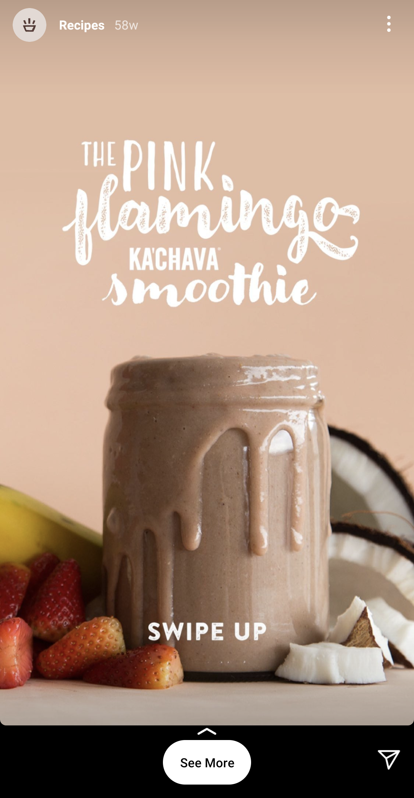
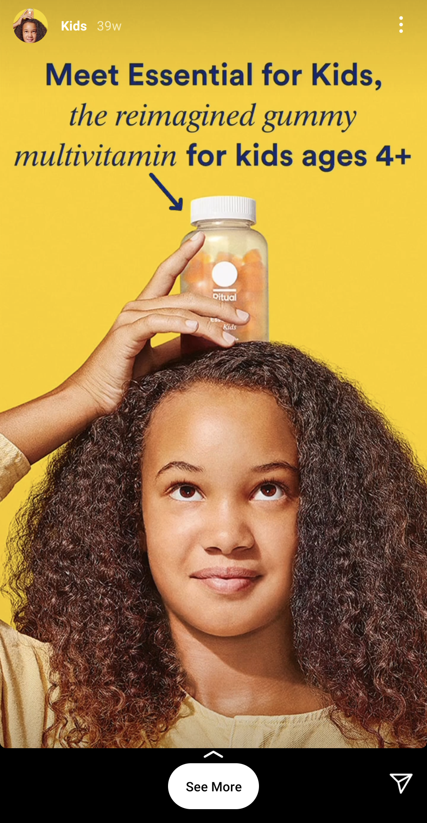
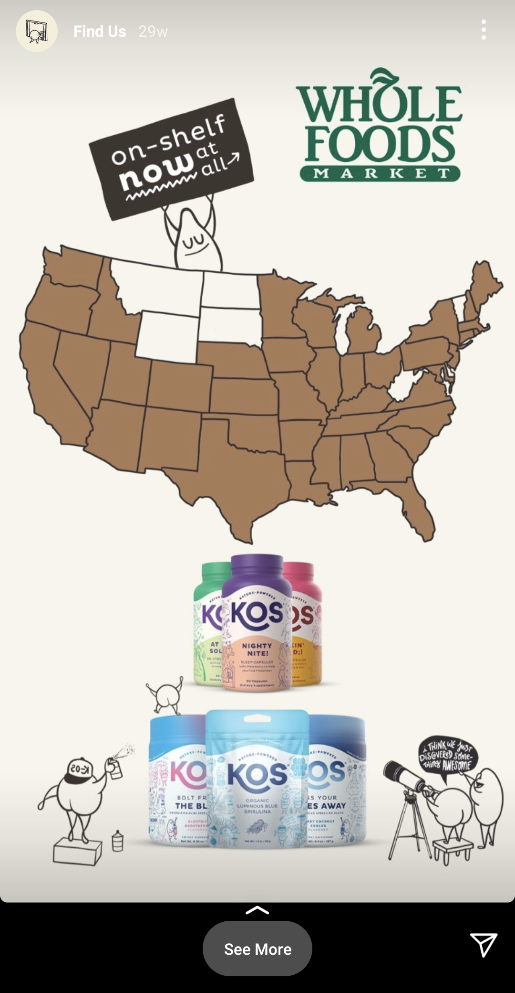
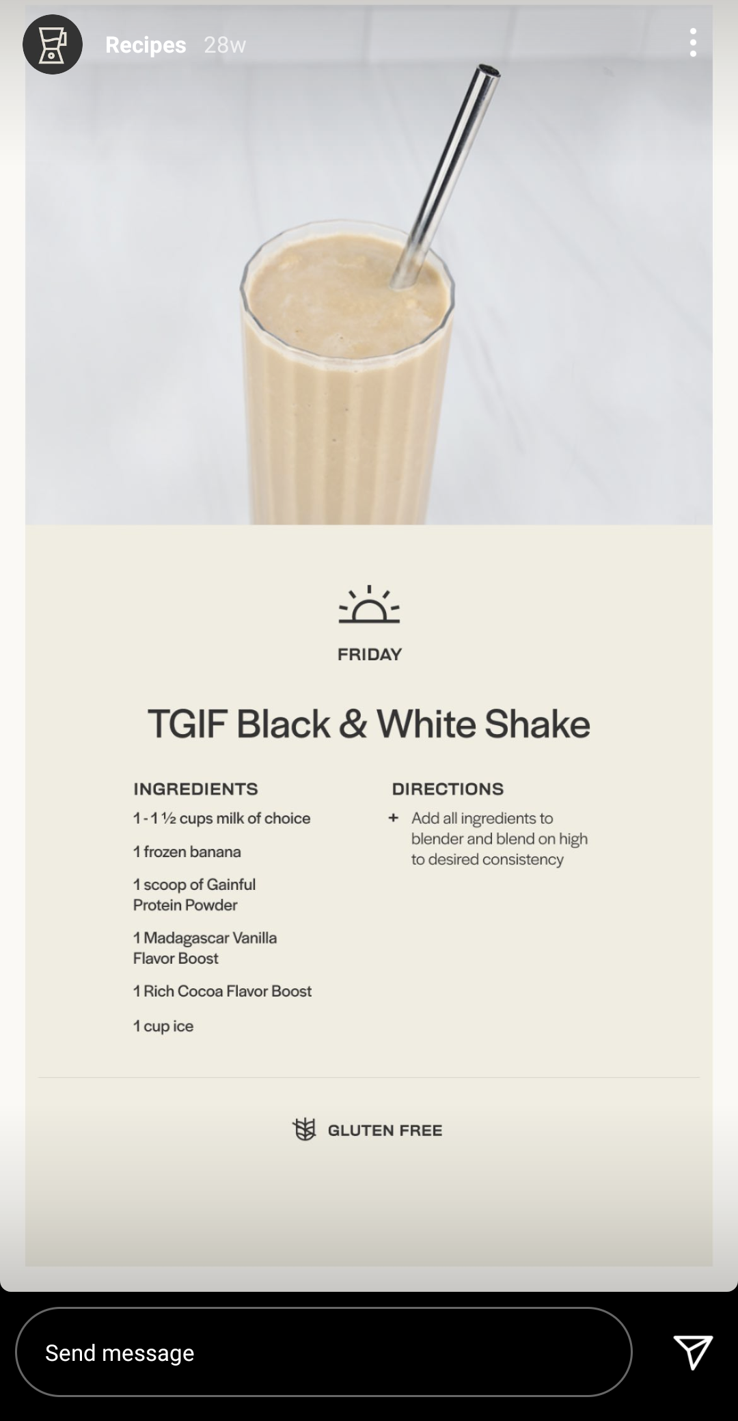

Slide 34
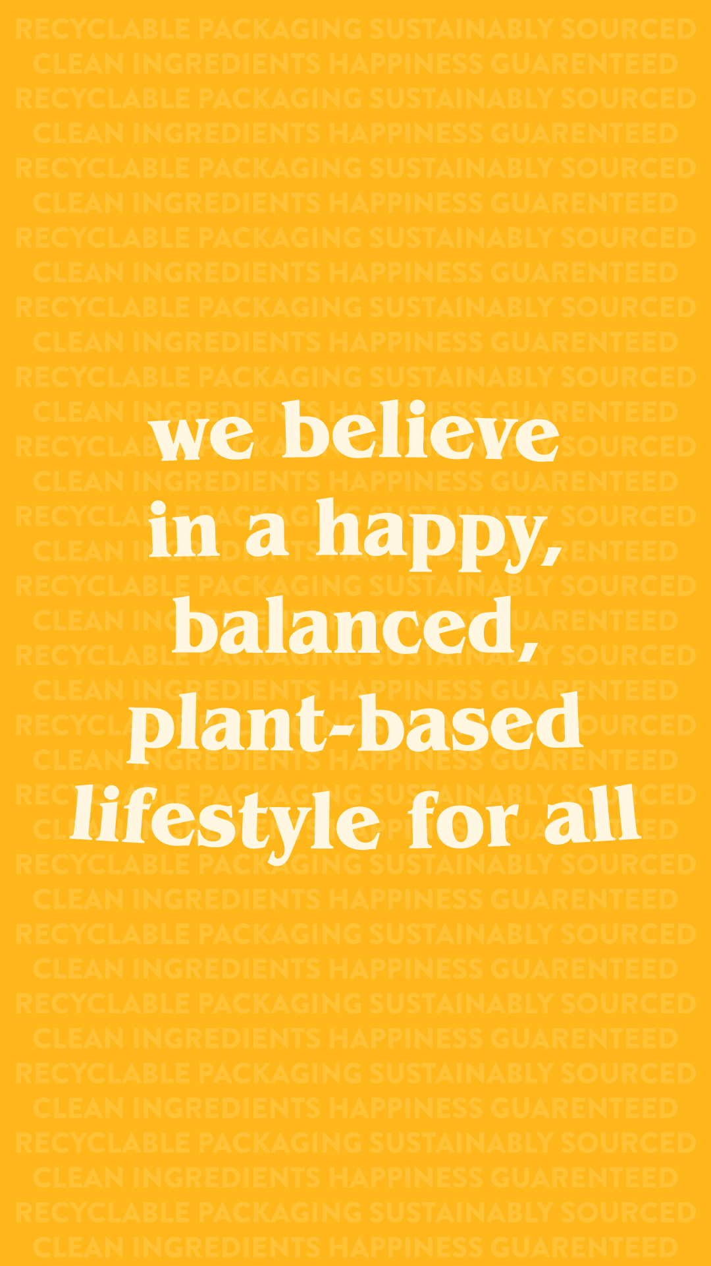
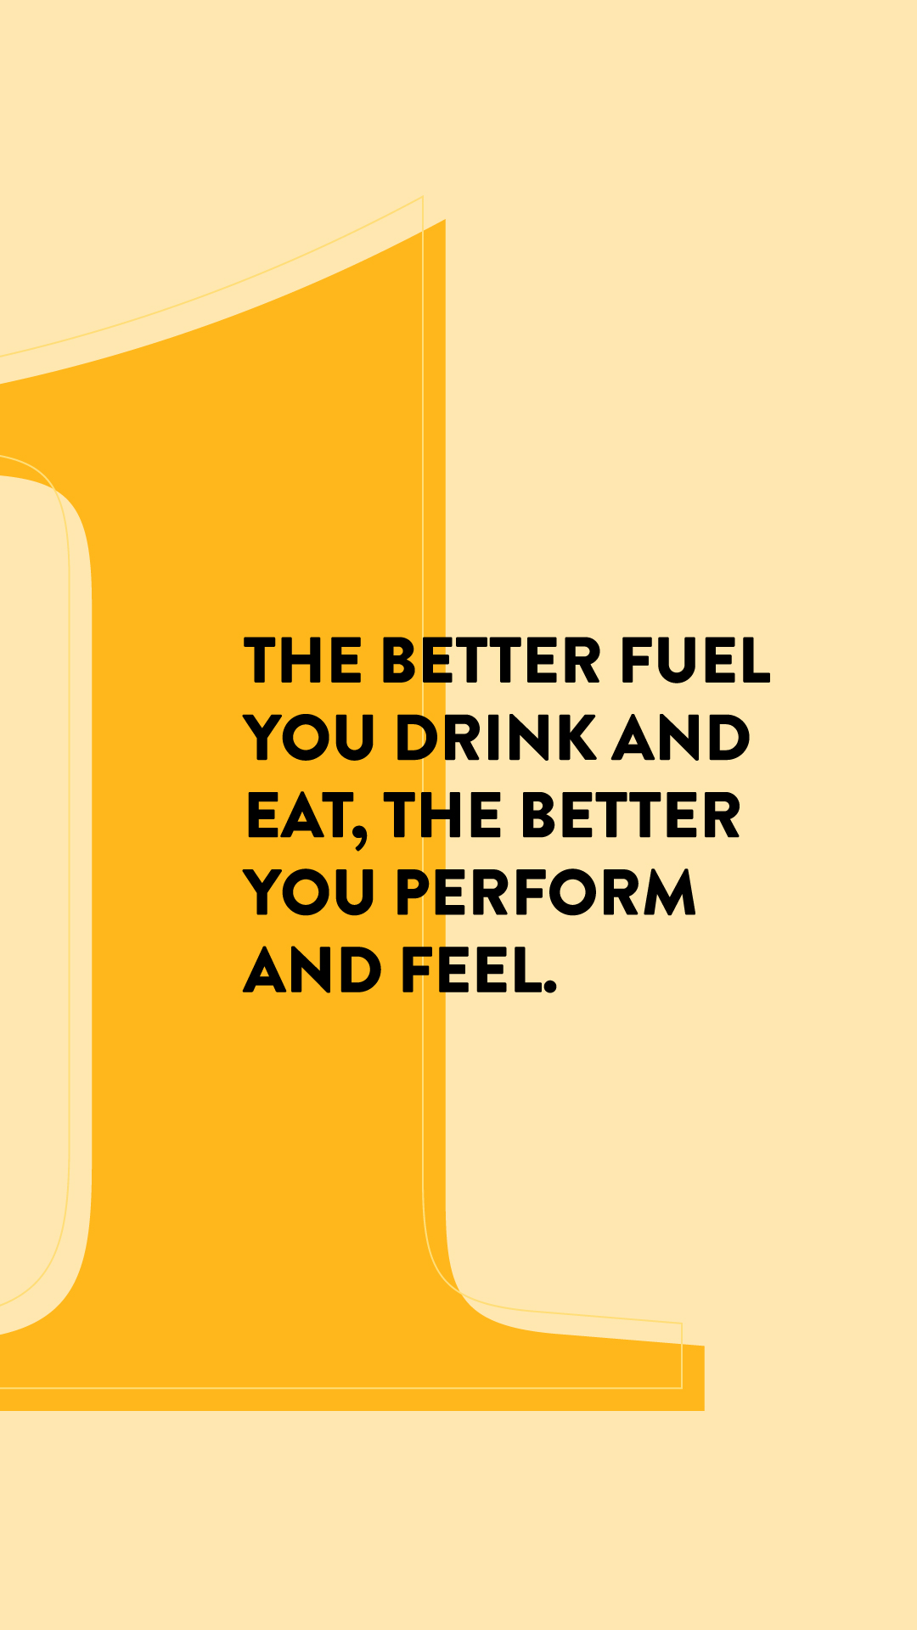
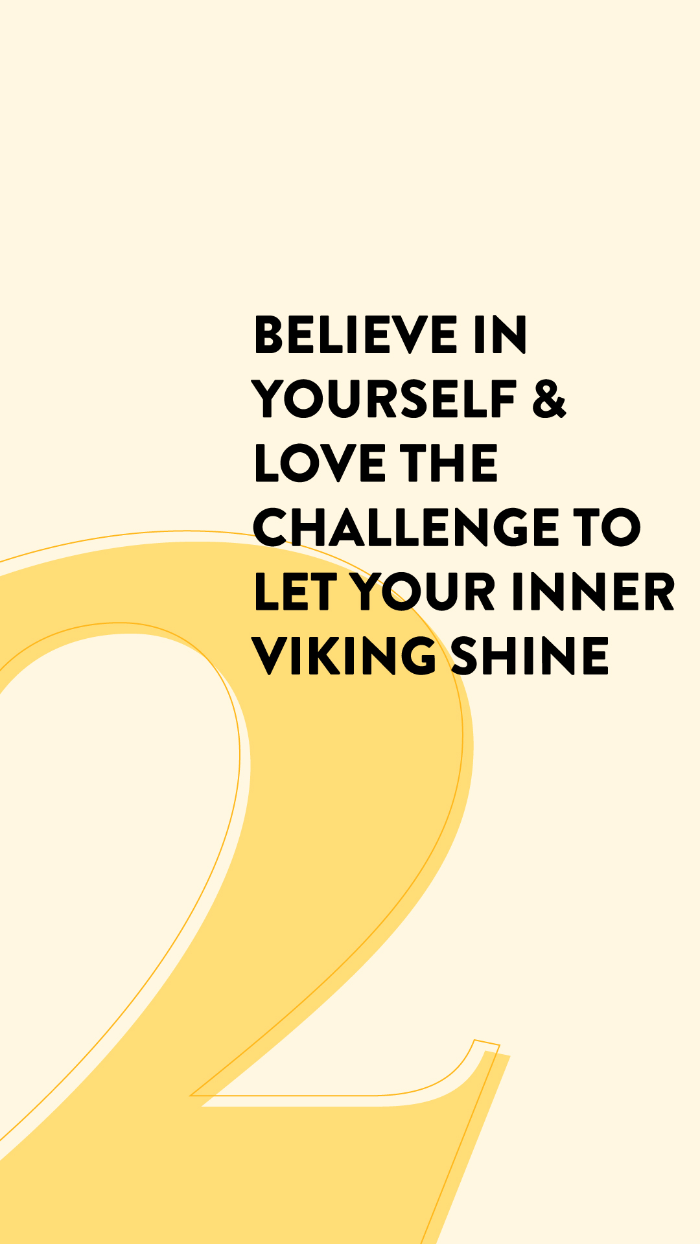
instagram highlights

Slide 35
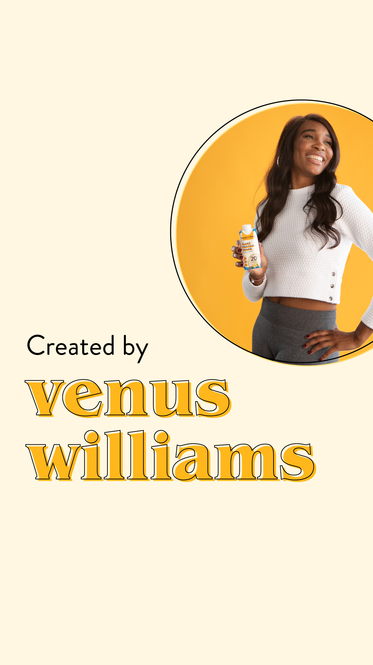
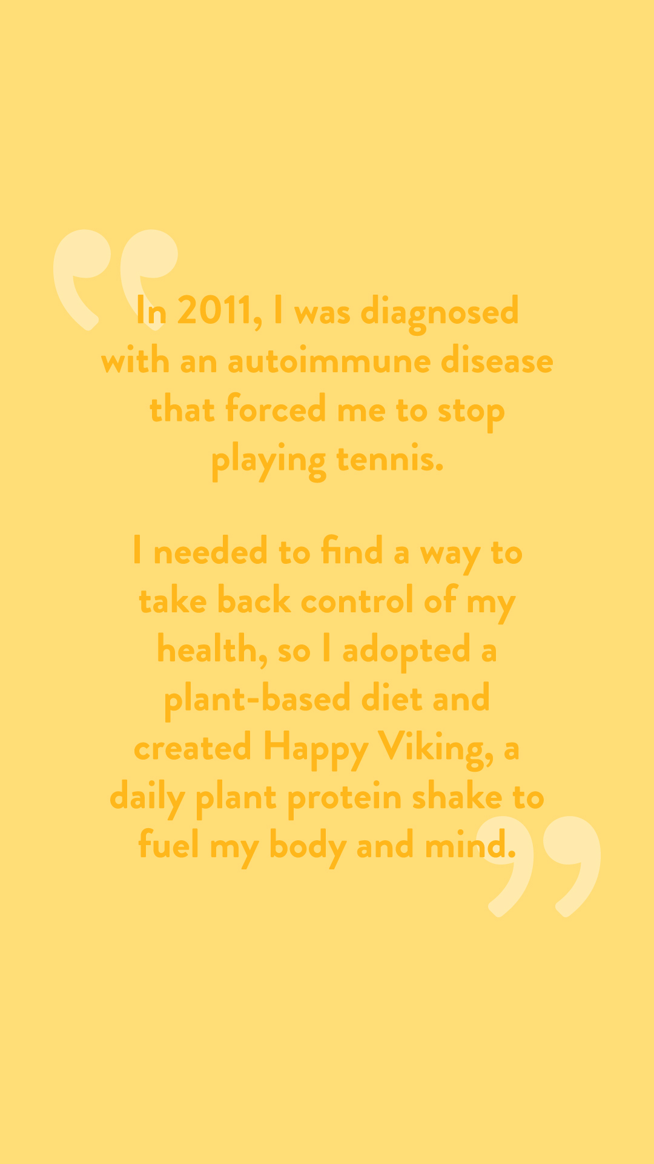
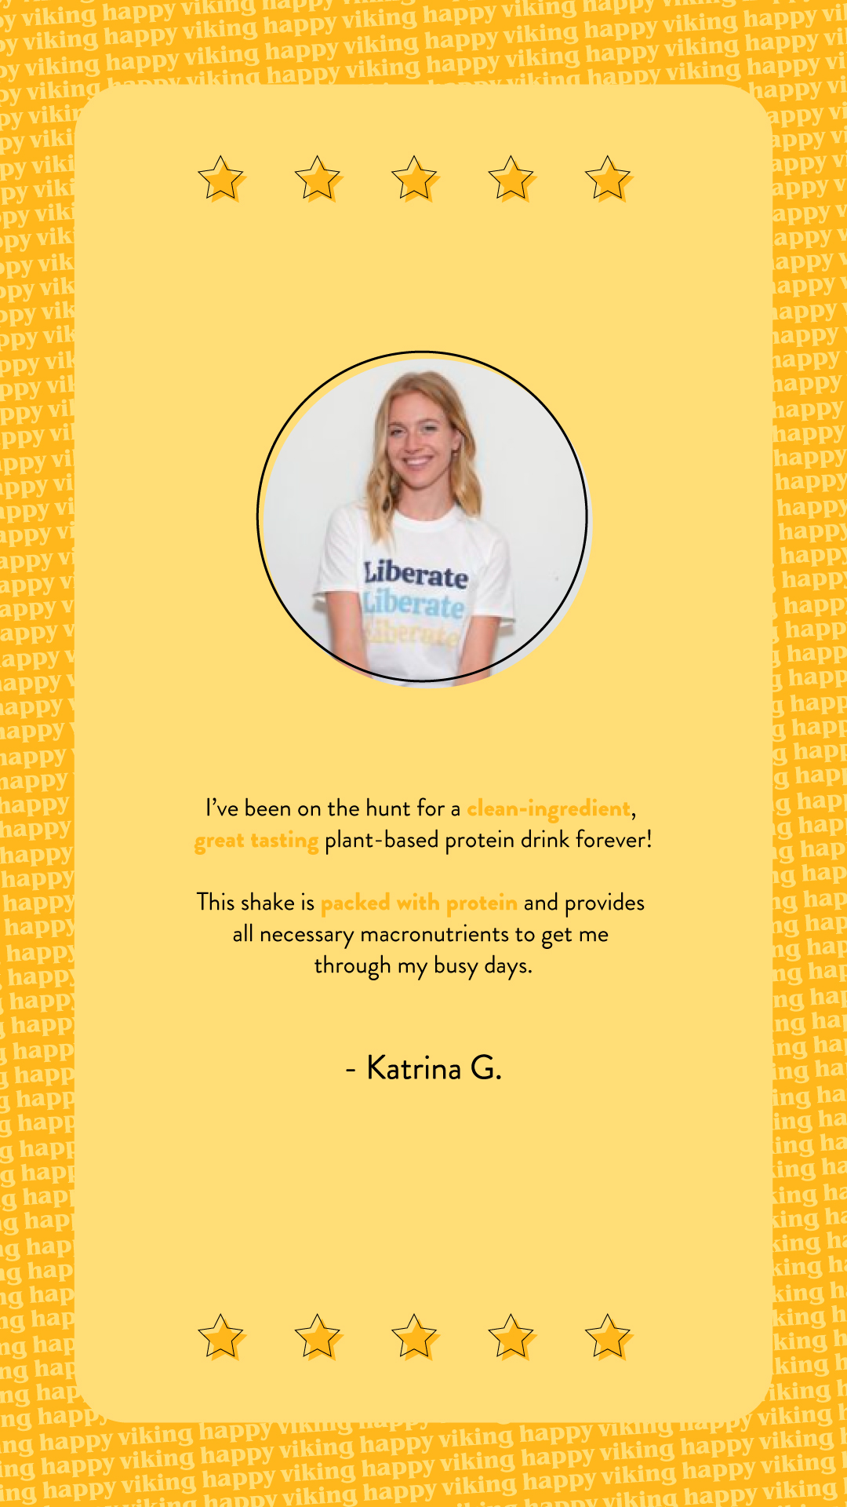
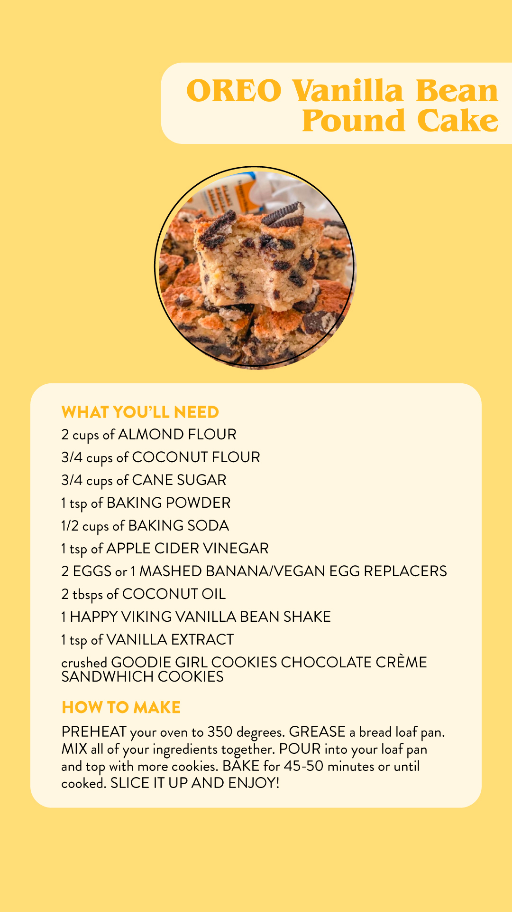
instagram highlights

Slide 36
internship takeaways
Understanding of strategy and research for content decisions
Videography and familiarity with Tik Tok and video-centric platforms
Community management and influencer marketing
Agency partnerships and overviews (Made by Colony)
…and of course, the connections and amazing DYLA team

