Slide 1
happy viking
Competitor Analysis Presentation
JEREMIAH ADEOLA

Slide 2
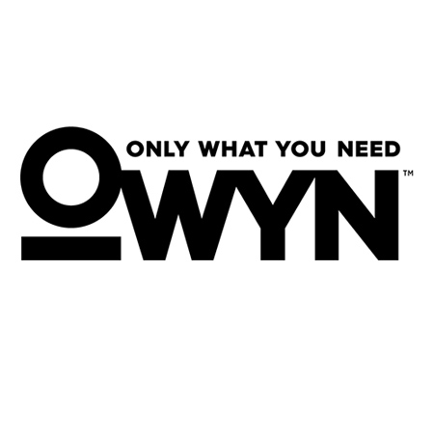

Slide 3
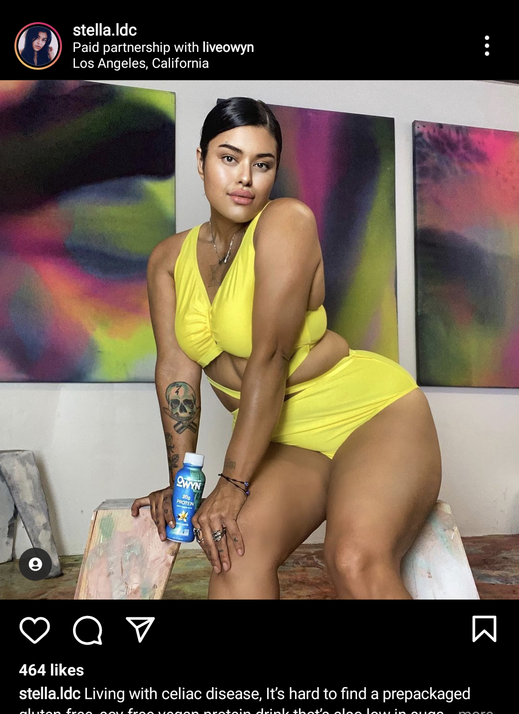
influencer strategy
Predominantly fitness lifestyle influencers
60/40 split between female/male
Occasionally advertised from workout recovery perspective with fitness
Lean towards larger audiences ~30K
One-off posts
Feature account specific discount codes to promote their partnership
20% off discount with code
OWYN Fans….

Slide 4
paid social strategy
*Ad research affected by age restrictions
Older campaigns utilized Facebook, Instagram, Audience Network, and Messenger
Newer ads only target Facebook and Instagram
Potentially higher CPC or CPR for Audience Network and Messenger
Healthy mix of both static (about 60%) and video (~40%) creative
Older video leaned into featured UGC
Directly named or assessed against non-plant-based nutrition solutions (Ensure)
Offers were previously linked to a landing page with an offer (20% off)
Currently directed straight to product page
Copy focuses on issues (stomachache, lumpy shakes, cheat meal and hunger cravings) as “not needed” and OWYN as a solution
Most of ad copy is geared towards building trust from its natural ingredients
Stresses free shipping
Potential solution to high add to cart abandonment

Slide 5
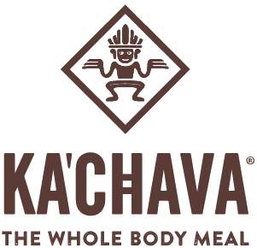

Slide 6
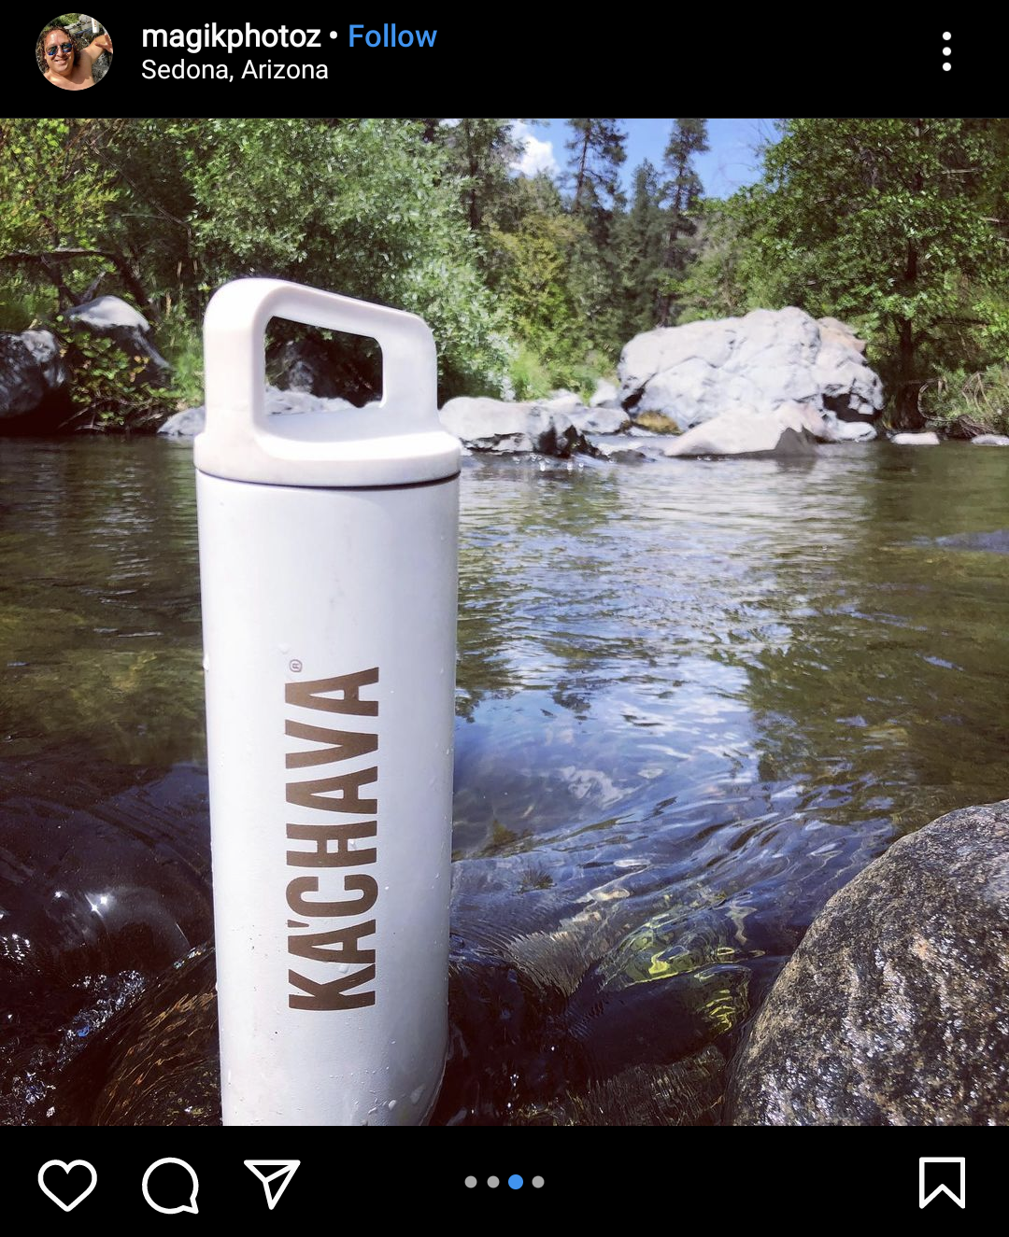
influencer strategy
Guerilla marketing strategy
All but 2-3 accounts (family, lifestyle, and recipe accounts) were under 5K followers
Larger accounts ranged from 26K to 75K
At least 2/3 of tags were recipe focused
Photographer tags
2+ posts from photography accounts using branded Ka’Chava bottle in scenic location
One-off posts
No promotional codes

Slide 7
paid social strategy
At least 80% of content focused on video creative
“Healthiest all-in-one meal shake”
“Made for health conscious people on-the-go”
Use of the branded bottle in nature scenes for creative
Started of with same video creative, some ads feature UGC reviews afterwards
Offers were previously linked to a landing page with combo pack offer (15% off)
Copy emphasizes “meal replacement” and “feeling your best” through natural ingredients that are included
“Meet the World’s Healthiest All-In-One Meal Shake”
B-roll focused on outdoors/adventurous aesthetic
Hiking, surfing, exploring nature

Slide 9
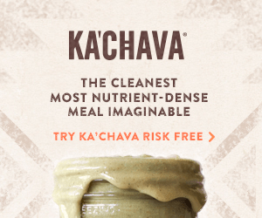
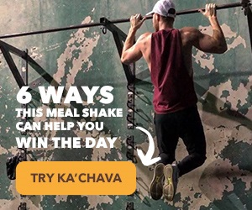
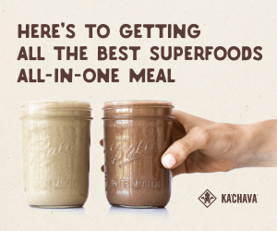
display ad strategy

Slide 10
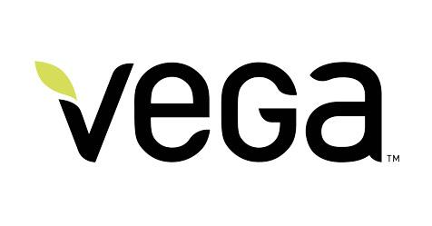

Slide 11
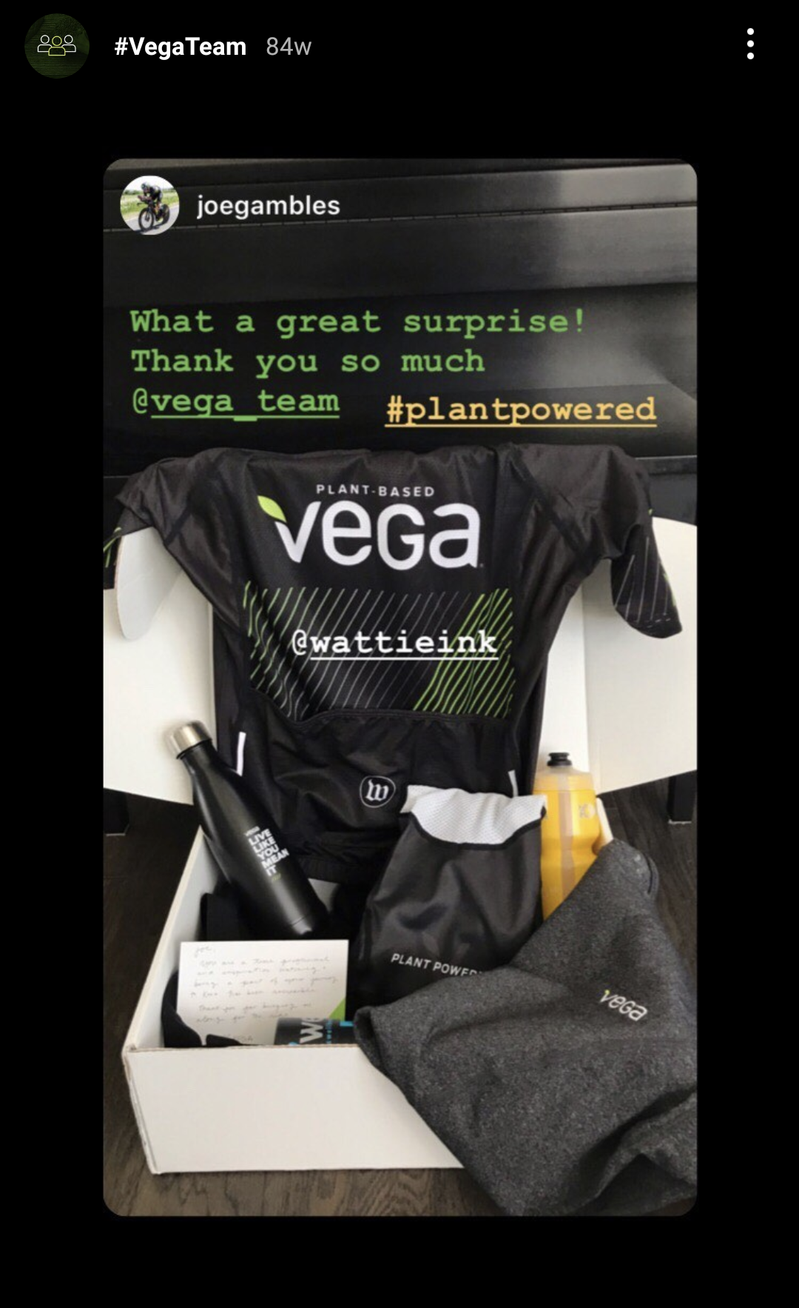
influencer strategy
Lifestyle influencers with few athletes (cycling and triathlon athletes)
60% of influencers featured smaller accounts of <10K with larger influencers having 100K+
Heavily focused on athletic performance
One-off posts
No promotional codes

Slide 12
paid social strategy
About 70/30 split between static/video content
“Fuel/Feel like the best”
Static creative often just generic product shots
Newer video content only featured on Facebook and Instagram instead of Audience Network and Messenger
Linked directly to product page
Older ad copy and creatives featured user reviews and testimonials

Slide 13
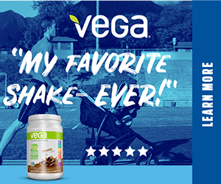
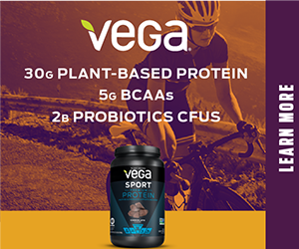
display ad strategy

